Slide 1
Wine Quality Case Study

Slide 2
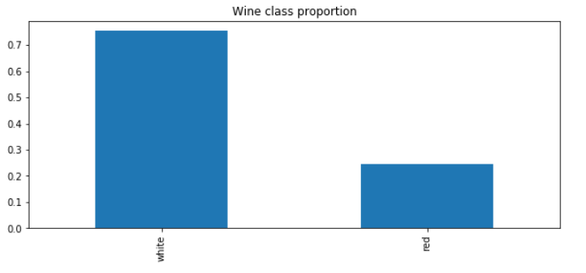
Proportional Representation of Feature ‘Style’ Around 74% belong to White and 24% belong to Red Wine category

Slide 3
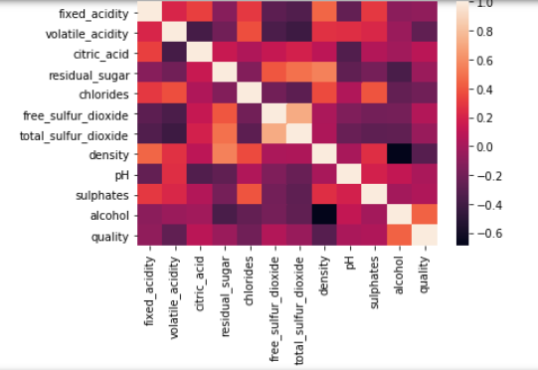
Correlation among the Features
0<Correlation<1 – Positively Correlated -1<Correlation<0 – Negatively Correlated
From this Heat map representation we can deduce that density and alcohol are negatively correlated and positive correlation exists between total_sulphur_dioxide and residual_sugar.

Slide 4
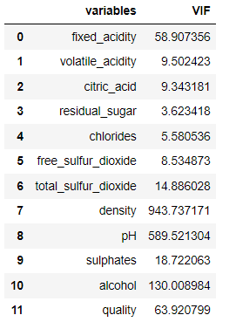
Multicollinearity
Multicollinearity is measured through Variation Inflation Factor (VIF). Generally if VIF>10 ,there exists Multicollinearity among the variables and those variables can be discarded. Here we could see density and pH are having very high values so we discarded them from our model.

Slide 5
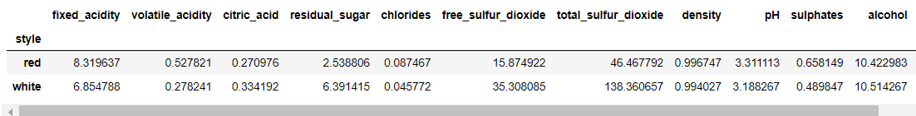
Grouped statistics for both classes of Wine
It seems that in average, red wine usually is less acid than white wine (pH is more for red wine compared to white wine) (the opposite is true when we look at volatile_acidity feature). The 'residual_sugar' in average is almost 3 times bigger for a white wine. The feature 'free_sulfur_dioxide' is highly and positive correlated with `total_sulfur_dioxide', which kind of makes sense.

Slide 6
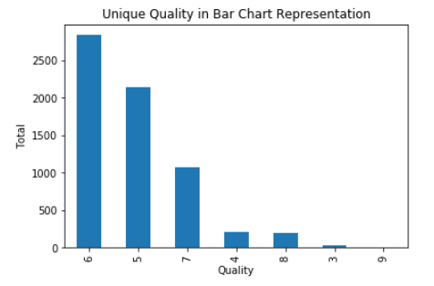
Bar Chart Representation of Quality Feature
As per the Bar Chart Representation 6 is the highest presence and 9 is the lowest.

Slide 7
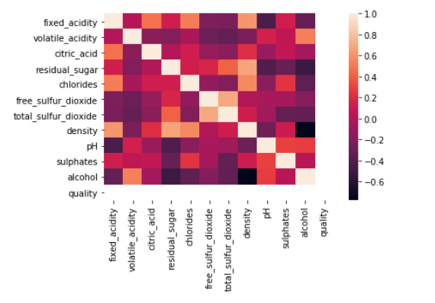
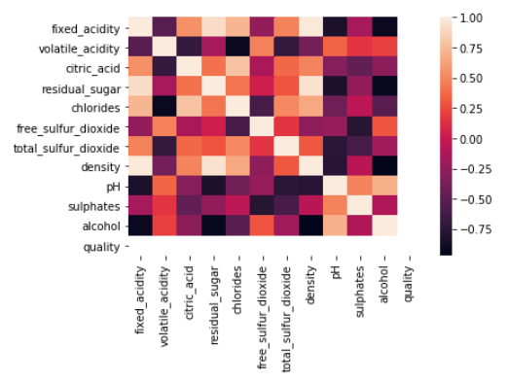
Comparison of Two Different Class Qualities For Quality level 9 (which is nearly very low in our case study) is having more negative correlation among the Features where as for Quality Level 8 is having considerable positive correlation among the features. Though Quality has less data present in the input data set.

Slide 8
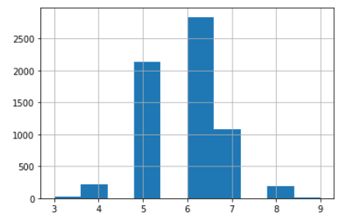

Histogram representation of Quality Feature
There are 6 unique qualities can be found from the given case study. These are 3,4,5,6,7,8,9.
As per the Histogram available Quality 6 is highest followed by 5 and so on.

Slide 9


